Slide 1





BUSINESS INTELLIGENCE - PART I
GROUP 23
Andreia Bastos, João Silva, Pauline Richard, Sarra Jebali

Slide 2


1
Introduction
TODAY'S AGENDA
2
Business Context and Understanding
3
Data Integration Process
4
Building our Dimensional Model
5
Conclusion

Slide 3







INTRODUCTION
For Who ? A major technology retail company that sells Apple's products in 5 different portuguese stores.
For what Goal ? Provide them with a solution that will give them a daily view of their product sales and cost
PART 1 - initial phase of cleaning data and creating a Dimensional Model

Slide 4

- 2 -
BUSINESS CONTEXT AND UNDERSTANDING
Notes:
Before building a data warehouse, it is important to have an overview of the business's
main operations.

Slide 5
BUSINESS CONTEXT
1
Sales performance of the business
2
The profile of their customers
3
The different types of families of products
Notes:
So we looked at some key figures and numbers to understand this retail company better, and divided in 3 different insights

Slide 6
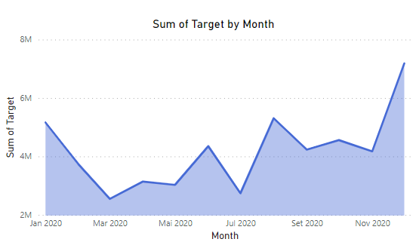
1.1 SALES PERFORMANCE
Overview of the monthly sales during 2020
Business is impacted by high seasonality
March and July = lowest profit
January, August, and December = highest profit
Figure 1: Sales by Month for the year 2020
Notes:
We started by displaying an
overview of the monthly sales during 2020. We could see, from the Area graph in Figure 1, that
the business is impacted by high seasonality.

Slide 7
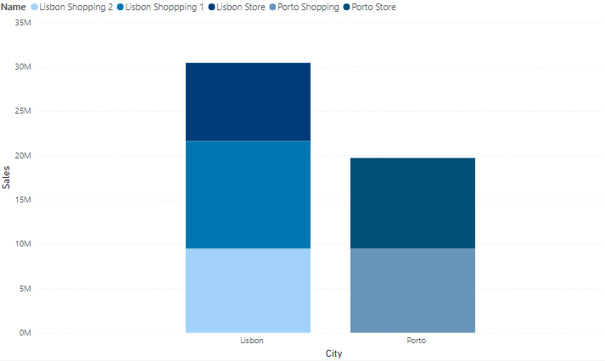
1.2 SALES PERFORMANCE
Performance of each of their 5 stores
Lisbon has the biggest sales volume
Additional store (3 are in Lisbon and 2 in Porto).
Figure 2: Sales volume of each store per City.
Notes:
Then, we analyzed individually the performance of their 5 stores, using a stacked bar chart. As we can see, Lisbon has the biggest sales volume, which can be expected bc of the
additional store

Slide 8
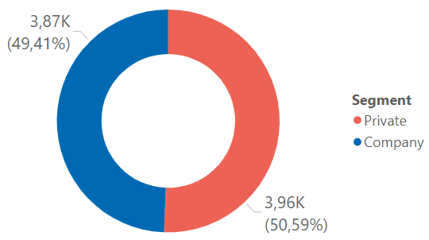
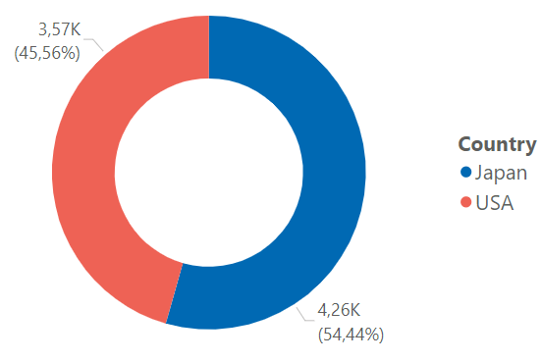
2.1 CUSTOMERS' PROFILE
Figure 3: Distribution per Segment
Characteristic of the customers
The Segment: Private Segment representing 50.59% and the Company one, 49.41%
The market: almost equal proportions
2 markets: Japan and USA
Figure 4: Distribution per Market
Notes:
In the second part, we looked at the profile of their customers.
1. First, the segment (who
is buying?). we can see that the distribution of clients
per segment is almost equal, between the Private and Company Segment
2. Second, we wanted to know where the clients are coming from? we can see they are divided into two distinct
markets: Japan and USA. The distribution shows a slightly bigger difference, with Japan doing
around 54% of the total purchases.

Slide 9
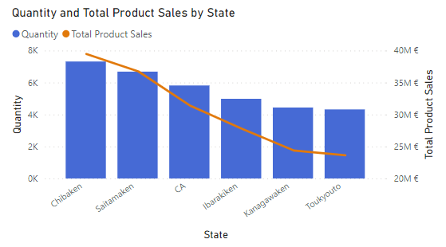
2.2 CUSTOMERS' PROFILE
Geographical Distribution
Top states that are buying the largest quantity of products
5 out of the 6 states are from Japan
Figure 5: Distribution per Market
Notes:
then we also looked geographically at the 6 top states that were
buying the largest quantity of products. 5 out of the 6 states are from Japan, which we can conclude is the major market

Slide 10
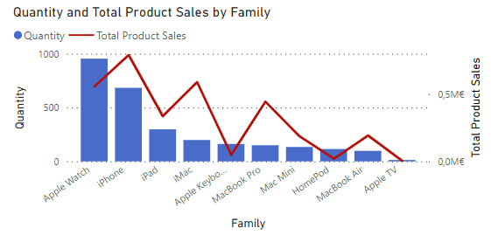
3. PRODUCT
Types of products sold
All products are tech products
From the same brand: Apple
Top Sales (quantity): Apple watches
Top Sales (revenue): Iphone
Figure 6: Total Quantity and Sales per Family of product
Notes:
Finally, we analyzed the different types of families of products sold. From Figure 6, we can first conclude that all products are tech products
coming from the same brand: Apple. We can also conclude that their Top Sales in terms of
quantity are the Apple watches, however, in terms of value, they are getting higher revenue from
selling the iPhone. Apple Tv, HomePod, and the Apple Keyboard are the three less profitable but ir can be explained by the difference in the unit price (for the apple keyboard) or
the quantity sold (Apple TV).

Slide 11


- 3 -
DATA INTEGRATION PROCESS

Slide 12


16
Spreadsheets
3.1 LOADING DATA SOURCES
2
Types of data
Business Related:
(Store, Customer, Product, ...)
Transaction
Related: (Invoices, InvoiceDetails, Target)

Slide 13



3.2 DATA TRANSFORMATION
TYPE CHANGE
MISSING AND NULL VALUES
STRING MANIPULATION
POWER QUERY FUNCTIONS
MERGING

Slide 14


- 4 -
BUILDING OUR DIMENSIONAL MODEL

Slide 15
1
Classify Entities
KIMBALL METHODOLOGY
Identify Hierarchies
2
Produce the Dimensional Model
3

Slide 16
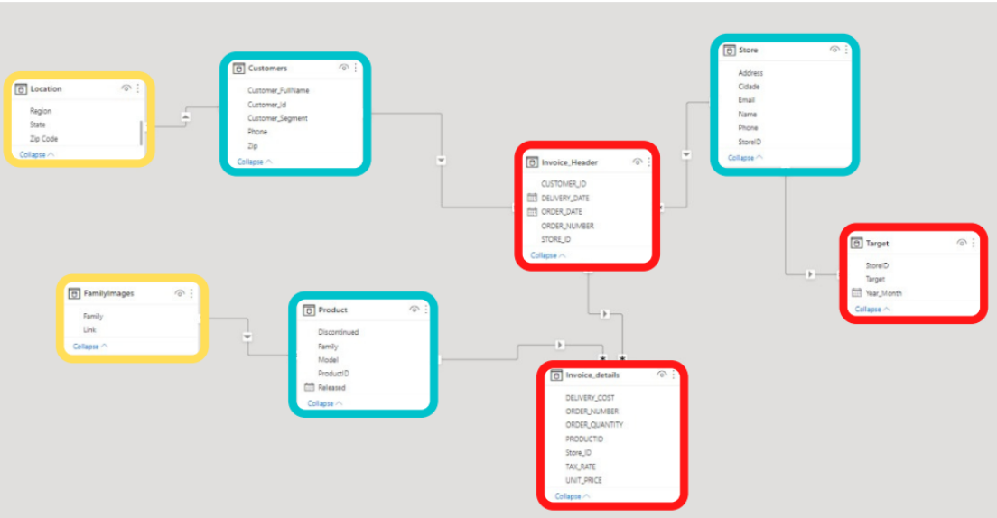
1
Classify Entities
Transaction
Component
Classification

Slide 17
2
Identify Hierarchies
HIERARCHY 1
HIERARCHY 2
LOCATION > CUSTOMERS > INVOICE_HEADER > INVOICE_DETAILS
FAMILYIMAGES > PRODUCT > INVOICE DETAILS
HIERARCHY 3
HIERARCHY 4
STORE > INVOICE_HEADER > INVOICE_DETAILS
STORE > TARGET

Slide 18
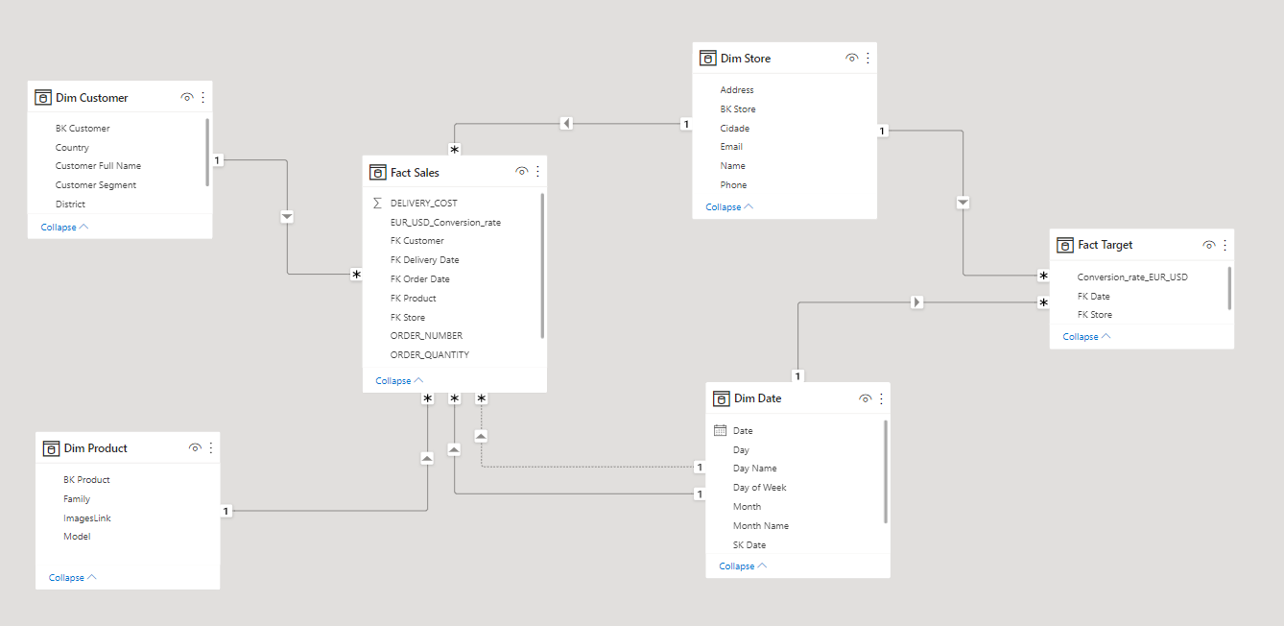
3
Produce Dimensional Models

Slide 19


Conclusion
Succeeded in the initial phase of cleaning data and creating a Dimensional Model.
Following the Kimball methods' best practices we managed to create solid grounds for the build of a successful Data Warehouse in the next phase of this project.

Slide 20


THANK
YOU!
Have a great day ahead.

